Slide 1

RSECon22 Walkthrough: A FAIR Data Pipeline: provenance-driven data management for traceable scientific workflows
7th September 2022
Ryan Field: Ryan.Field@glasgow.ac.uk
Richard Reeve: Richard.Reeve@glasgow.ac.uk

Slide 2

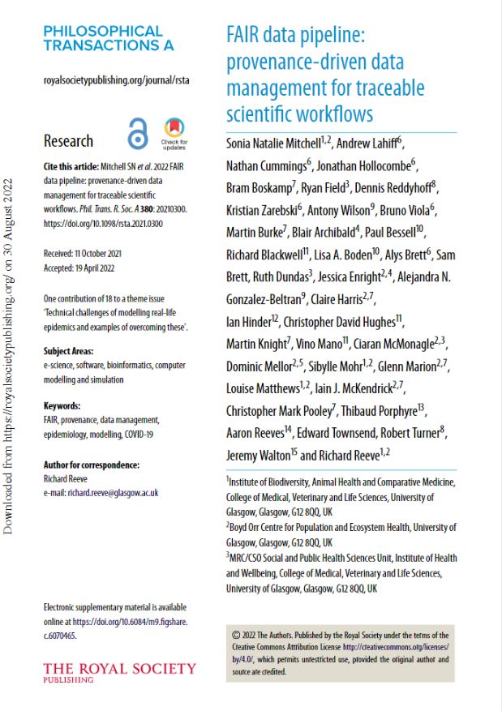

Slide 3
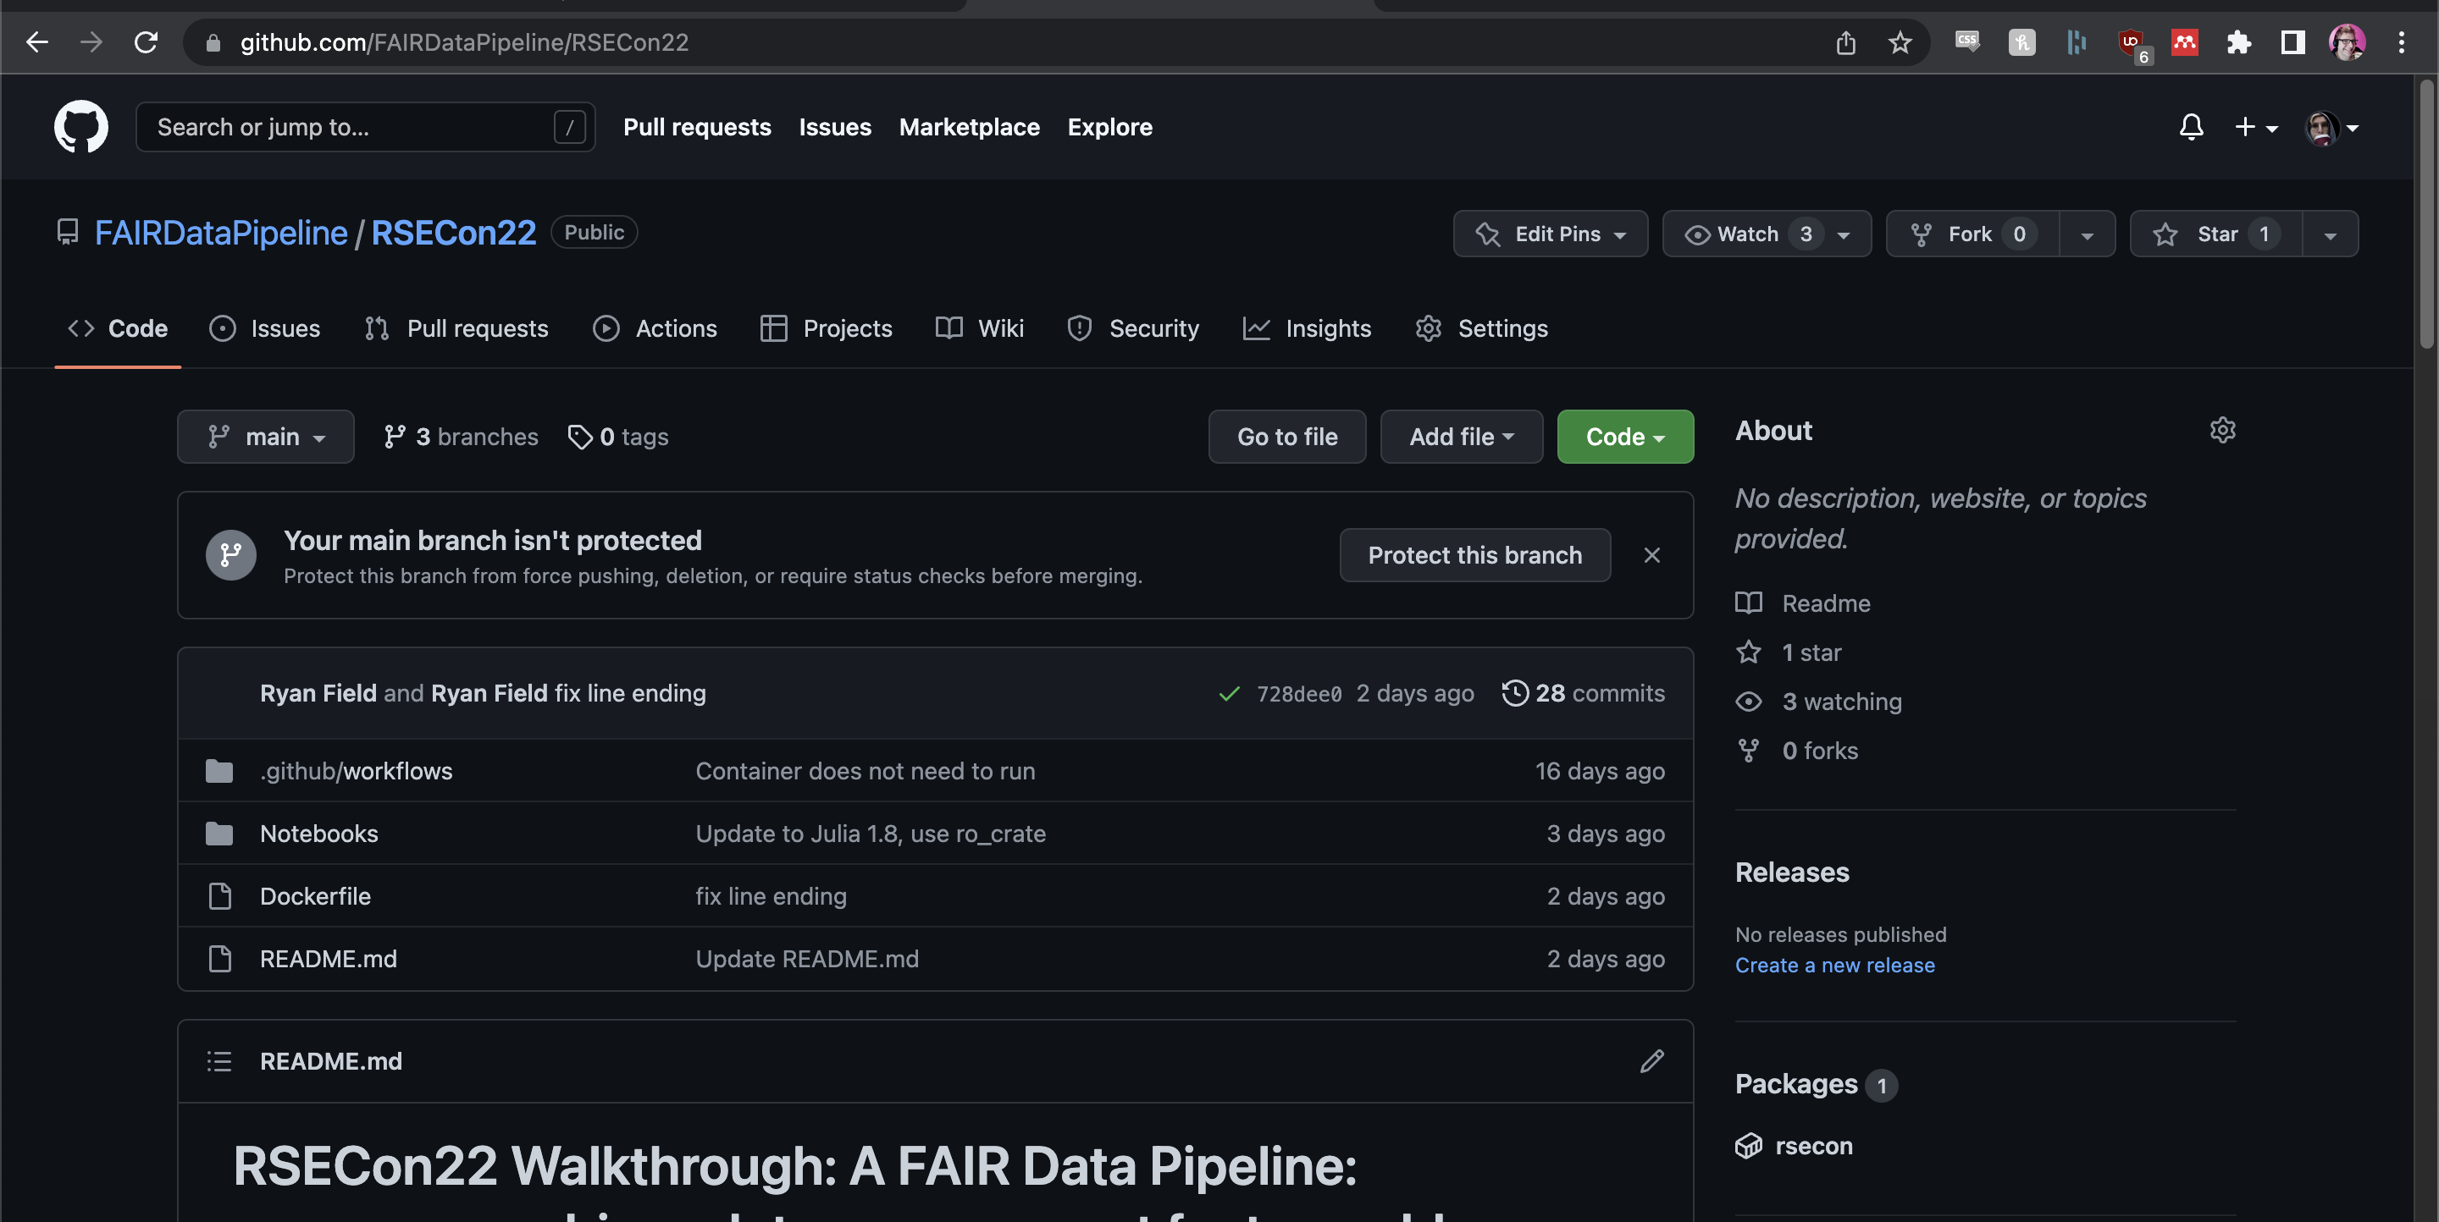

https://github.com/FAIRDataPipeline/RSECon22

Slide 4


WHY?
FAIR
Findable
Accessible
Interoperable
Reusable
Traceability / Provenance
Validity

Slide 5

Reinventing the Wheel?

Slide 6
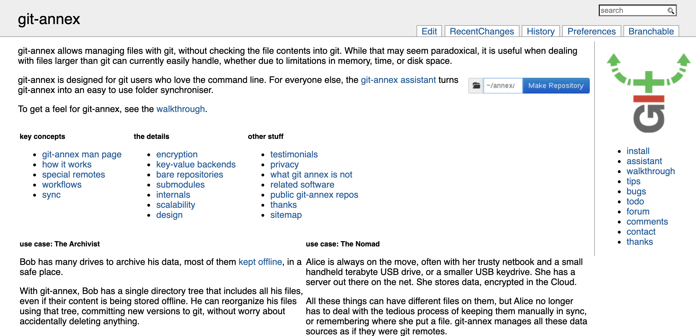

Slide 7
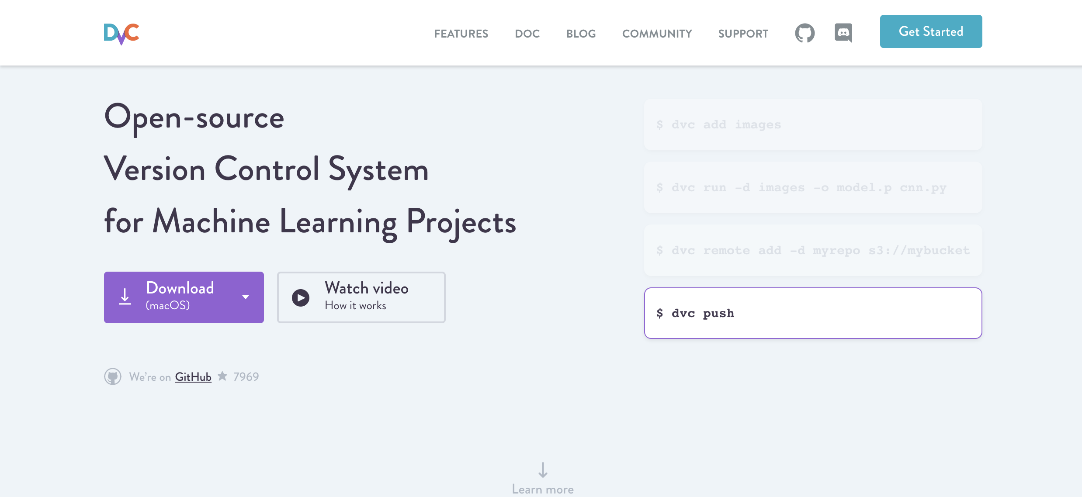

Slide 8
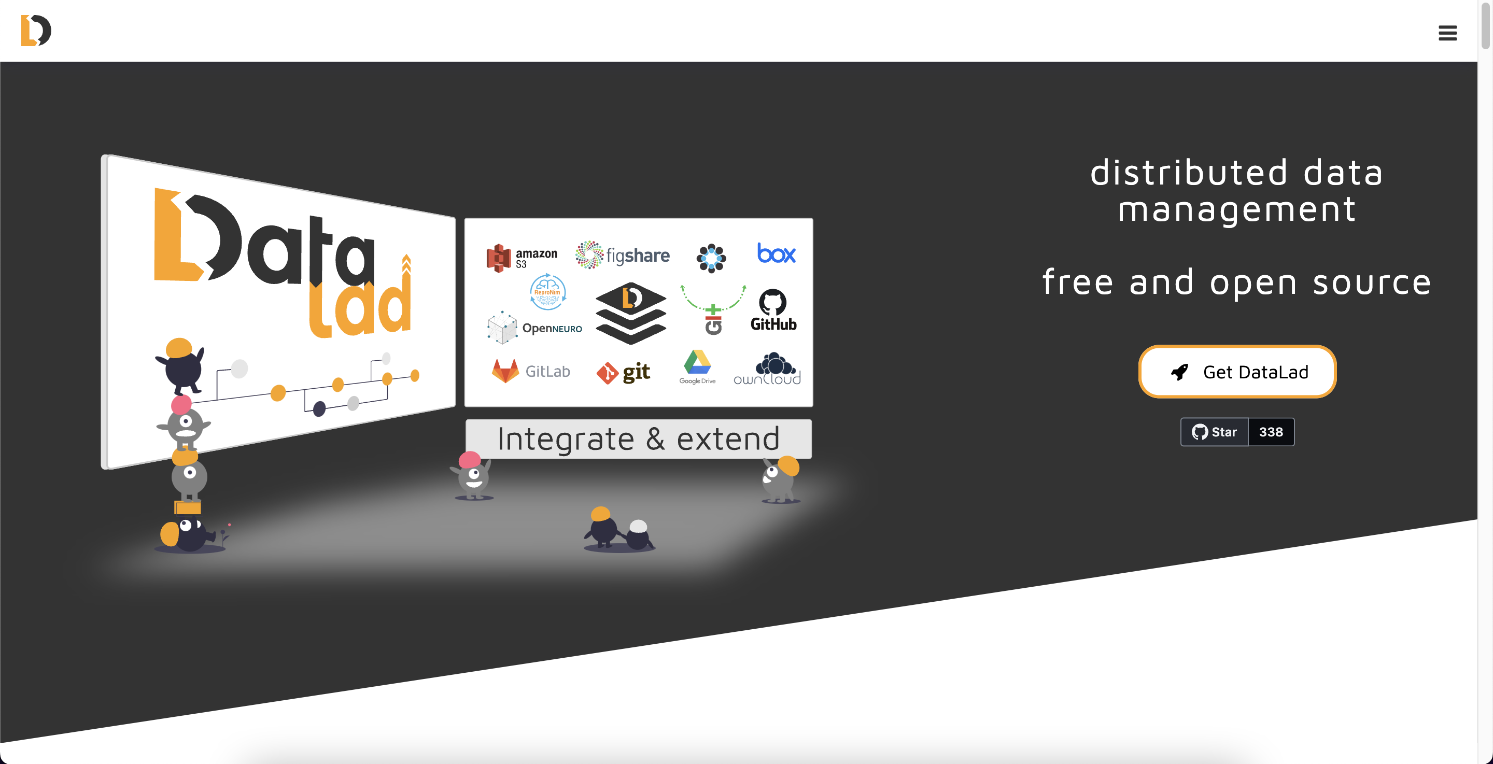

Slide 9
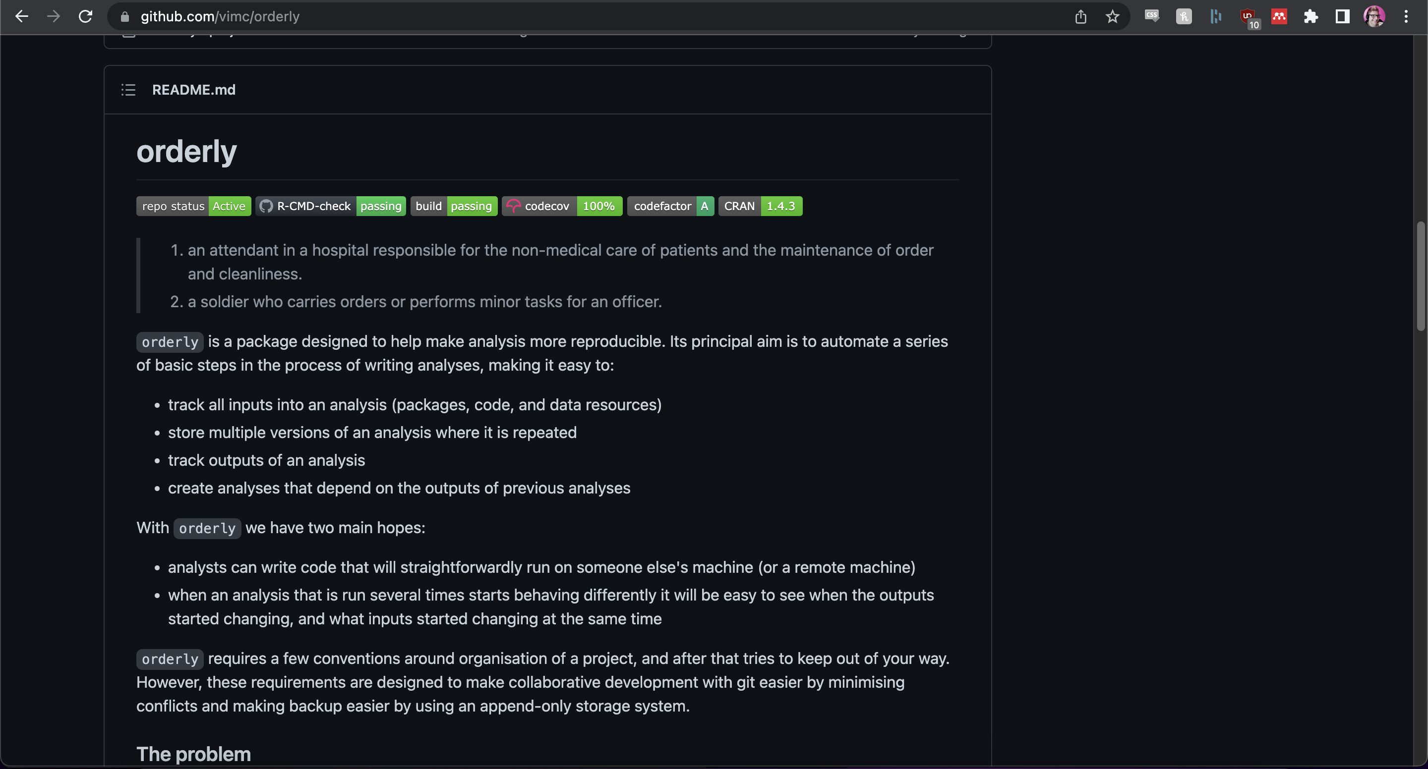

Slide 10
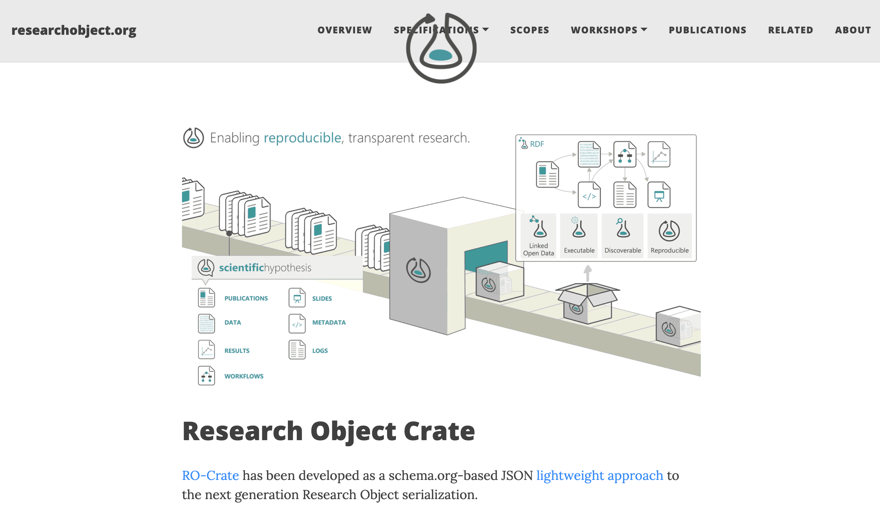

Slide 11
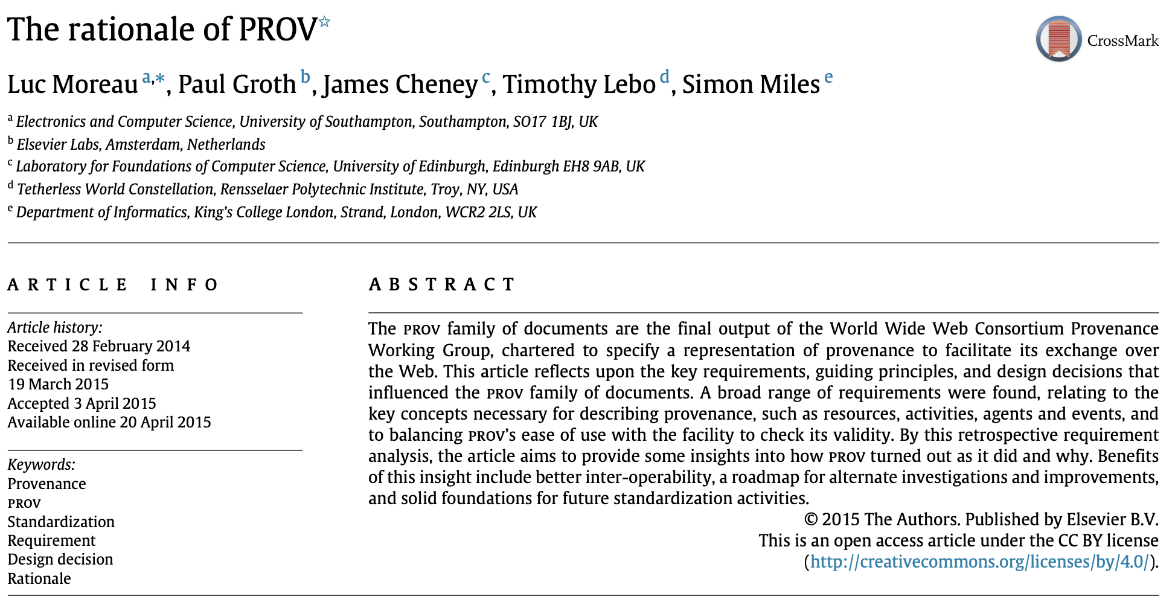
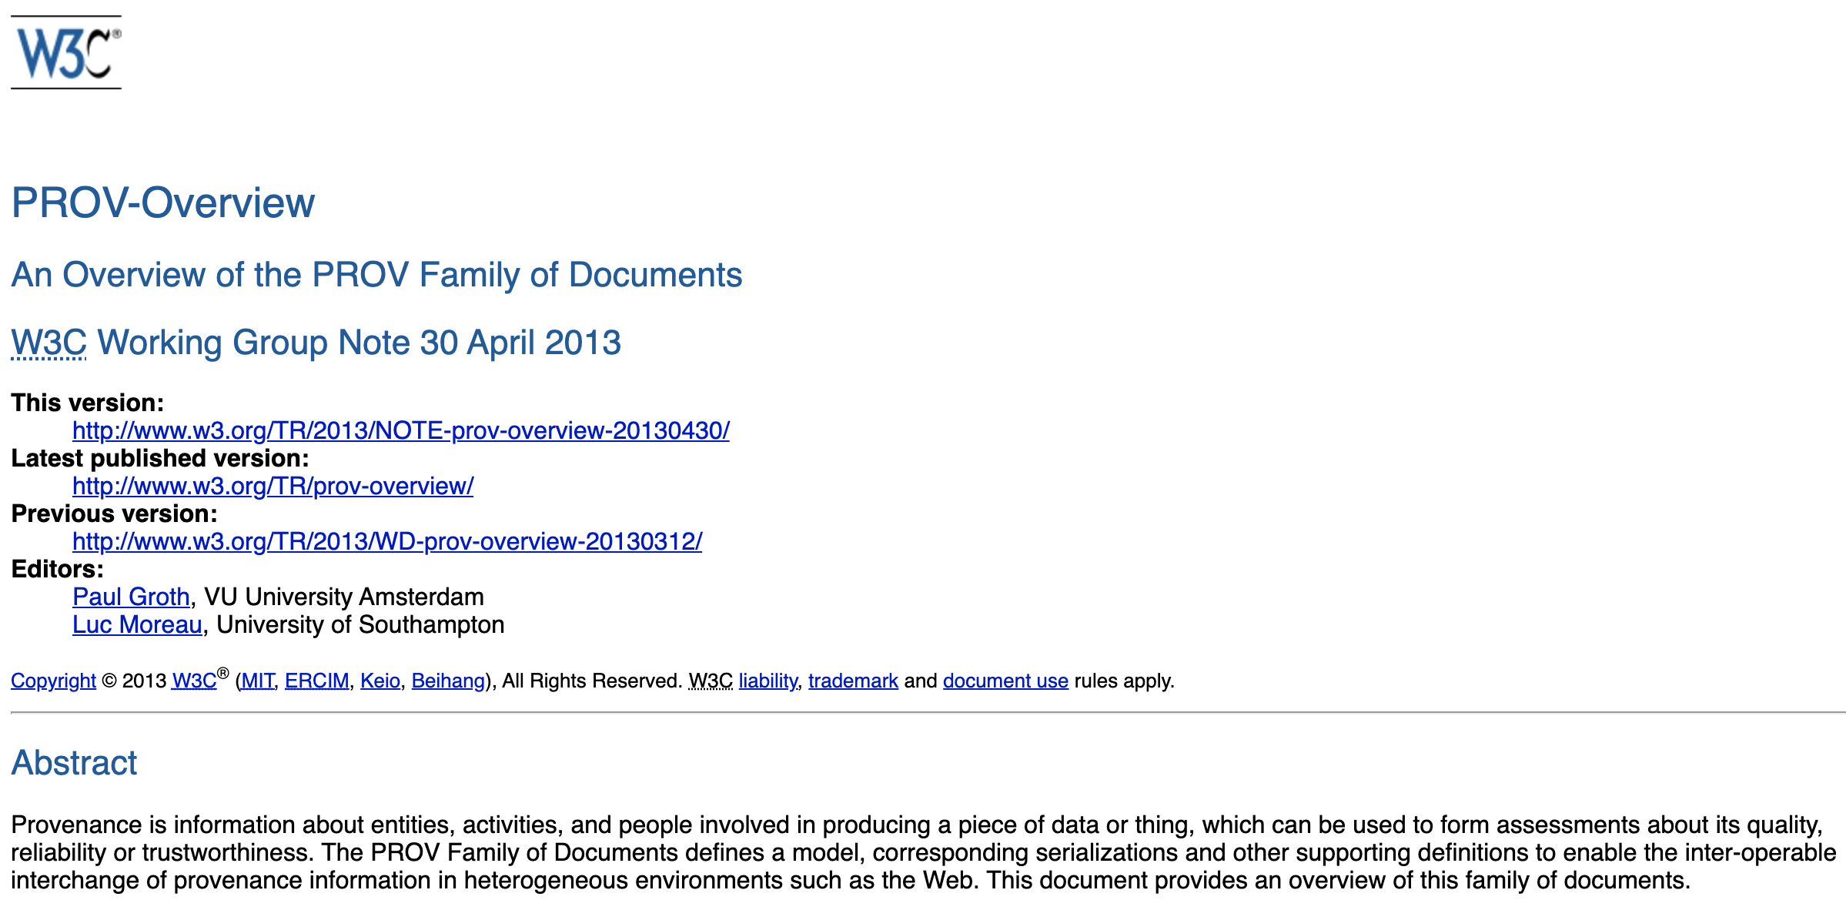
Open Provenance

Slide 12
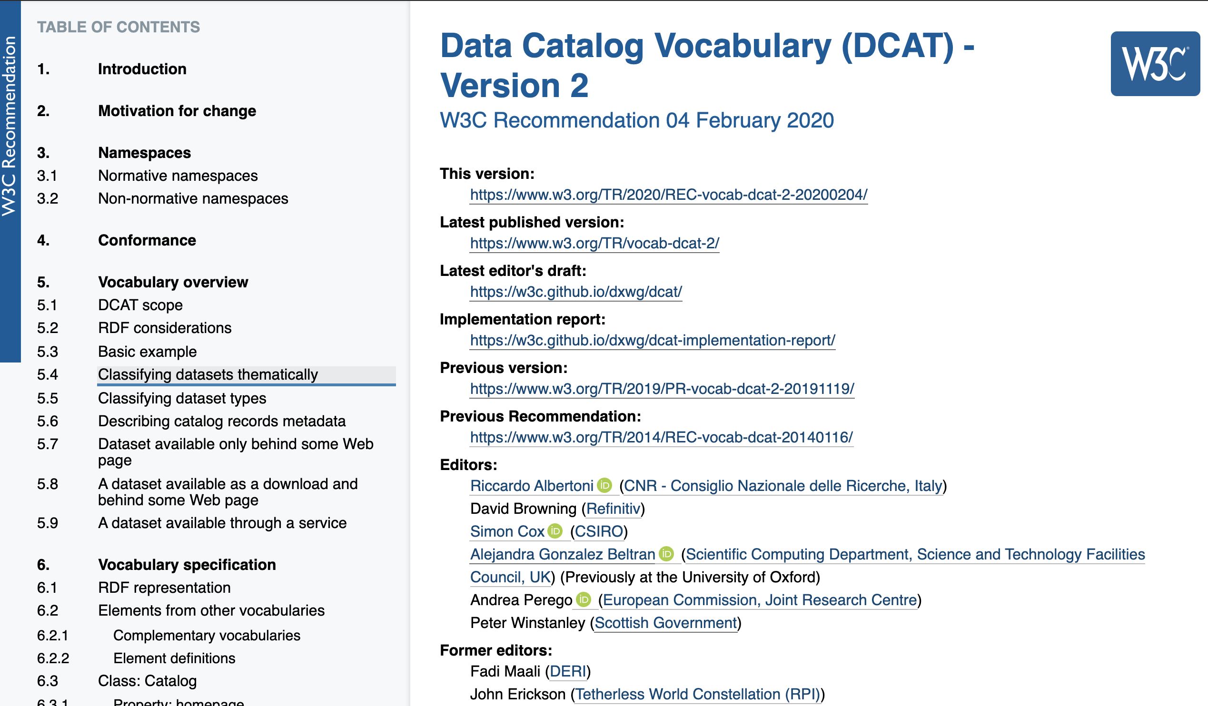
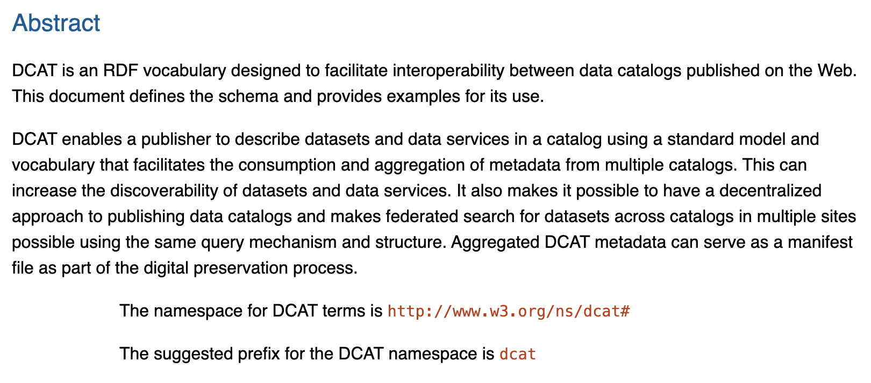
Open Metadata

Slide 13
FAIR Data pipeline
Reporting
External sources
Models
External sources
Models
External sources
Code (Java, C++, Python, Julia, R)
External sources
Data repository
Data repository
Data repositories
Sync download
Model configuration script (yaml)
Pipeline API
initialise(.)
finalise(.)
read_estimate(.)
...
read_array(.)
read_table(.)
Local filesystem data repository
Remote Data registry
Sync upload
write_estimate(.)
…
write_array(.)
write_table(.)
Local Data registry
raise_issue(.)
record_read(.)
record_write(.)
Data and metadata flow
Register source data in local pipeline
Download inputs to local registry
Upload to / download from local pipeline
Upload outputs to permanent registry
Reporting on registry contents
Component
Provided by user
Core pipeline / SCRC
From other source
Generated by pipeline

Slide 14
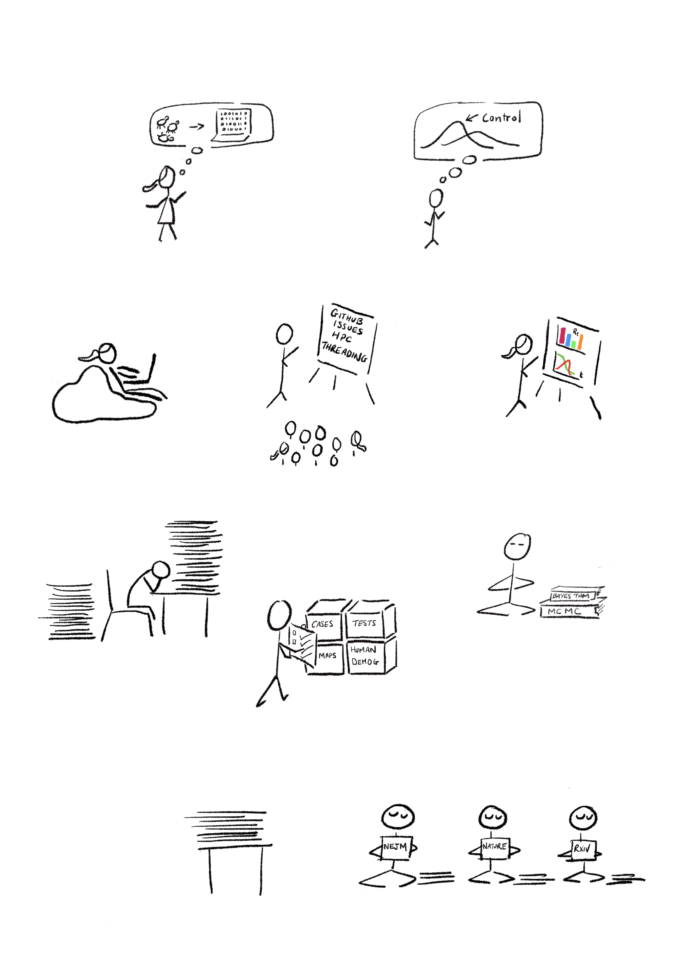


https://www.fairdatapipeline.org/
Universities of Glasgow, Edinburgh, SRUC, Sheffield, Manchester,
St Andrews, Stirling, Strathclyde, Heriot-Watt, Southampton,
Cambridge, Oxford, Swansea, Bangor, Nottingham, York,
Middlesex, City, U. of London, Warwick, Chester, Exeter,
King’s College London, Loughborough, EPIC,
Biomathematics and Statistics Scotland,
UK Atomic Energy Authority, Met Office, Software Sustainability Institute,
Man Group, Invenia,
Horus Security,
Red Sift Ltd,
and others
This work was undertaken in part as a contribution to the Rapid Assistance in Modelling the Pandemic (RAMP) initiative, coordinated by the Royal Society

